Slide 1
Database searching and multiple alignment: investigating antibiotic resistance
BIO 300/CMPSC 300
Dr. Kristen Webb
Spring 2016

Slide 2
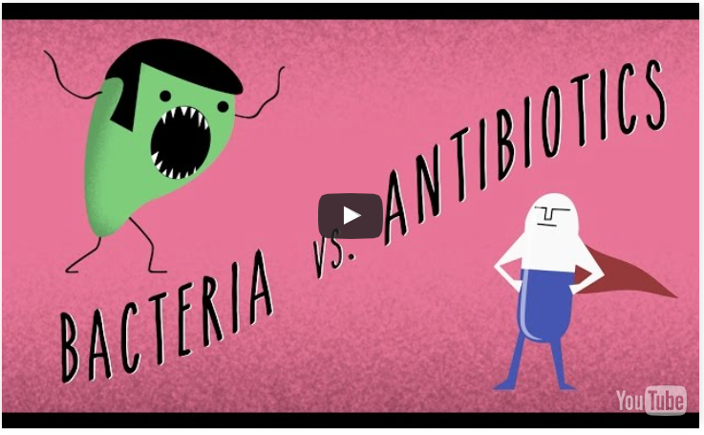
Antibiotic Resistance http://ed.ted.com/lessons/how-antibiotics-become-resistant-over-time-kevin-wu

Slide 3
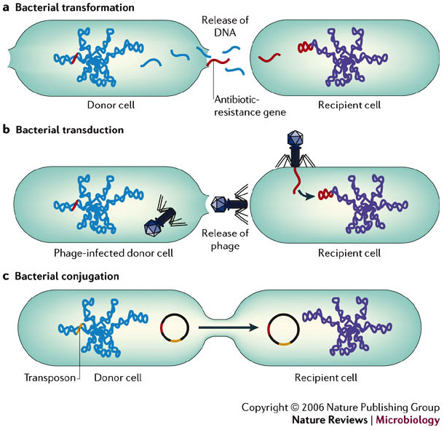
Horizontal Gene Transfer
Horizontal gene transfer (HGT) refers to the transfer of genes between organisms in a manner other than traditional reproduction.

Slide 4
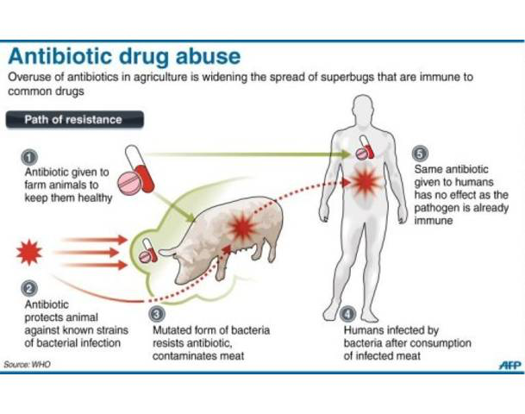
Farm-to-Fork Spread of Antibiotic Resistance

Slide 5
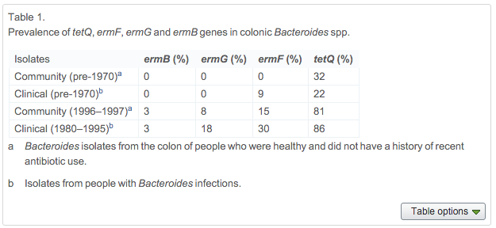
Farm-to-Fork Spread of Antibiotic Resistance Salyers et al 2004

Slide 6

BLAST: A Heuristic Approach to Database Searching
Basic Local Alignment Search Tool
NCBI – DNA and protein sequence
Compares one sequence to database of > 100 million
Finds best hits (optimal alignments) in a matter of seconds
(would take >3 years using Needlman-Wunsch algorithm)

Slide 7
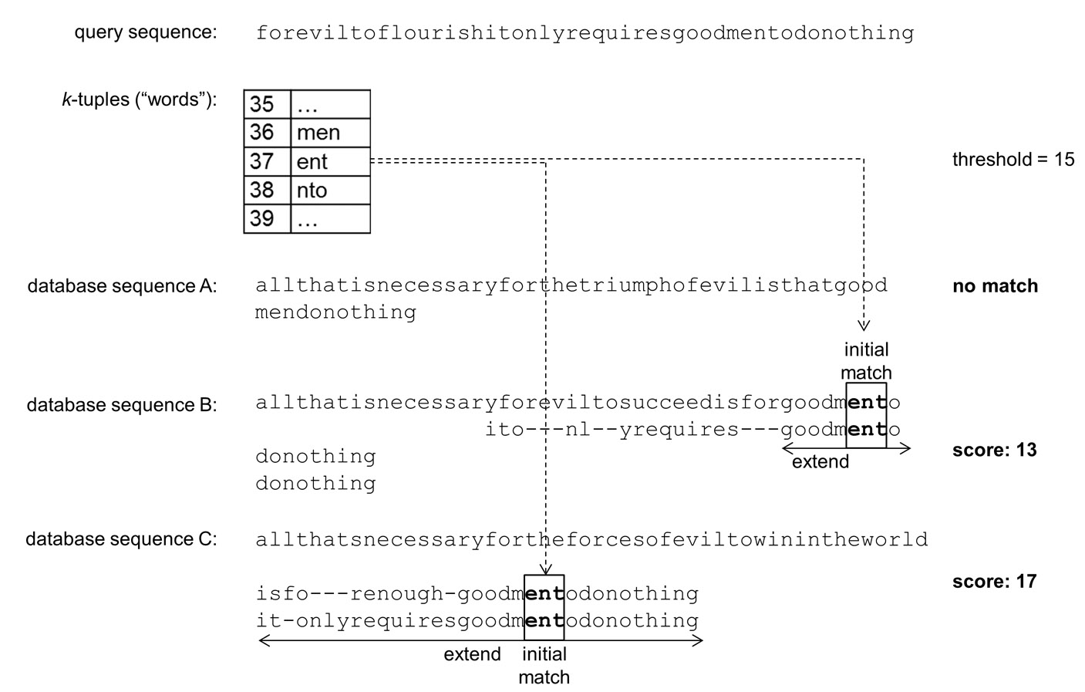
BLAST: A Heuristic Approach to Database Searching

Slide 8
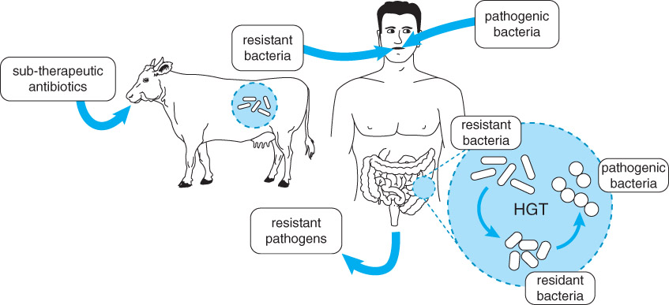
Horizontal Gene Transfer of Antibiotic Resistance

Slide 9
What is the likelihood that agricultural use of antibiotics is resulting in resistant human gut bacteria and/or resistant human pathogens?
ermB gene

Slide 10
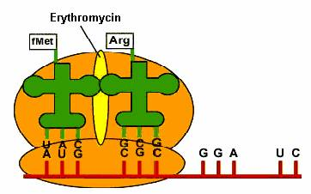
Searching for Erythromycin Resistance Genes Using BLAST
Erythromycin – binds to bacterial ribosome and blocks translation

Slide 11
Searching for Erythromycin Resistance Genes Using BLAST
Resistant strains of bacteria
ermB - new gene – modifies part of the ribosome so erythomycin can’t bind

Slide 12
What is the likelihood that agricultural use of antibiotics is resulting in resistant human gut bacteria and/or resistant human pathogens?
ermB gene – codes for a protein that methylates rRNA so erythromycin can’t bind – antibiotic resistance gene
Generate FASTA-formatted file of diverse ermB genes using BLAST
Diverse species

Slide 13
Multiple Sequence Alignment: Clustal and MUSCLE
Align a set of sequences (2 – ~2,000)
May find distinctly identifiable groups - evolution
Can create a consensus sequence: the nucleotides (or amino acids) that appear the most frequently at each position in a set of sequences

Slide 14
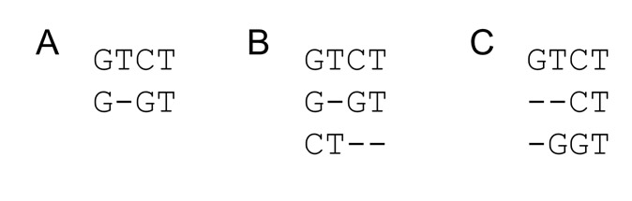
Multiple Sequence Alignment: Clustal
Order matters
Solutions?
Needleman-Wunsch L x M x N matrix
Impractical for long sequences
Heuristic
Progressive alignment via a guide tree

Slide 15
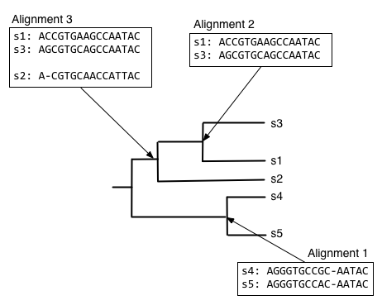
Multiple Sequence Alignment: Clustal
Heuristic
Progressive alignment via a guide tree
Pairwise alignments, group sequences together based on similarity
Start with most closely related species
Global, pairwise alignments to align each new sequence with those already aligned in order of decreasing relatedness

Slide 16
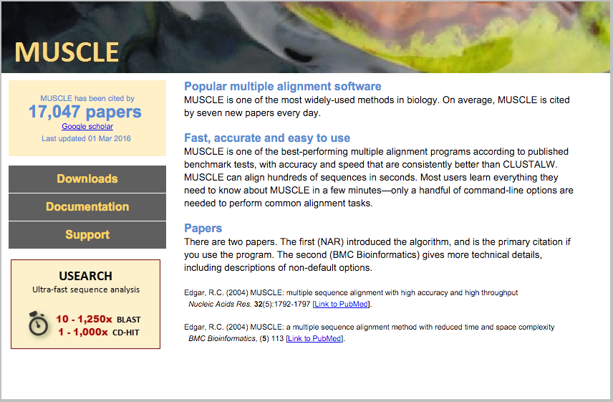
Multiple Sequence Alignment: MUSCLE

Slide 17
What is the likelihood that agricultural use of antibiotics is resulting in resistant human gut bacteria and/or resistant human pathogens?
ermB gene – codes for a protein that methylates rRNA so erythromycin can’t bind – antibiotic resistance gene
Generate FASTA-formatted file of diverse ermB genes using BLAST
Diverse species
Generate multiple alignment and tree

Slide 18
Summarize your findings regarding the likelihood that agricultural use of antibiotics can result in resistant human gut bacteria and/or resistant human pathogens
Preliminary evidence to support or reject hypothesis of Horizontal Gene Transfer of ermB
Bacterial species/hosts used – why chosen/rationale?
Screenshot of alignment and tree
Evidence for or against HGT?
Next steps to continue investigation…

